Slide 1
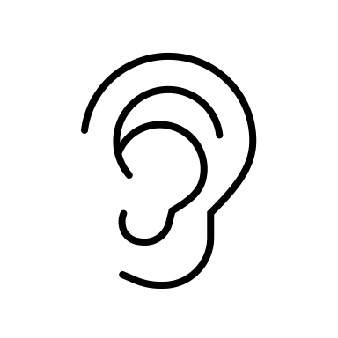
Education Infographic
Word pictures used to communicate feelings, experiences, observations, people, places, or ideas.
What is Imagery?
What Are the Tools of Imagery?
100%
100 %
100%
What is the Foundation of Creative Writing?
IMAGERY
Figurative Language
Sensory Imagery
Sound
100%
Figurative Language
Sensory Imagery
Creates a mood
Affects reader’s emotions
Figurative language is word constructions that reflect an intentional departure from the normal order, construction, or meaning of words in order to:
1. gain strength and freshness of expression 2. to help the reader understand an unfamiliar feeling or experience 3. to create a pictorial effect 4. or to discover and illustrate similarities between dissimilar things.
Ask these questions?
What does _____ taste like?
What does _____ look like?
What does _____ smell like?
What does _____ feel like?
What does _____ sound like?

Slide 2
Education Infographic
Simile: linking or equating two ideas using like or as
Example: Peace is like
Metaphor: directly equating to things
Example: Peace is
Type 1:
Similes & Metaphors
OH PLEASE, LET IT BE LIGHTNING We were crossing the headwaters of the Susquehanna River in our new car we didn’t quite have the money for but it was slick and silver and we named it after the local strip club next to the car wash: The Spearmint Rhino, and this wasn’t long after your mother said she wasn’t sure if one of your ancestors died in childbirth or was struck by lightning, there just wasn’t anyone left to set the story straight, and we started to feel old. And it snowed. The ice and salt and mud on the car made it look like how we felt on the inside. The dog was asleep on my lap. We had seven more hours before our bed in the bluegrass would greet us like some southern cousin we forgot we had. Sometimes, you have to look around at the life you’ve made and sort of nod at it, like someone moving their head up and down to a tune they like. New York City seemed years away and all the radio stations had unfamiliar call letters and talked about God, the one that starts his name with a capital and wants you not to get so naked all the time. Sometimes, there seems to be a halfway point between where you’ve been and everywhere else, and we were there. All the trees were dead, and the hills looked flat like in real bad landscape paintings in some nowhere gallery off an interstate but still, it looked kind of pretty. Not because of the snow, but because you somehow found a decent song on the dial and there you were with your marvelous mouth, singing full-lunged, driving full-speed into the gloomy thunderhead, glittery and blazing and alive. And it didn’t matter what was beyond us, or what came before us, or what town we lived in, or where the money came from, or what new night might leave us hungry and reeling, we were simply going forward, riotous and windswept, and all too willing to be struck by something shining and mad, and so furiously hot it could kill us.
Ada Limón, from Bright Dead Things (Milkweed Editions, 2015)
Ask these questions?
What does _____ taste like?
What does _____ look like?
What does _____ smell like?
What does _____ feel like?
What does _____ sound like?
And then ask why it does.
... We had seven more hours before our bed in the bluegrass would greet us like some southern cousin we forgot we had.
simile
Midnight, Talking About Our Exes
The sun is still down and maybe even downer. Two owls, one white and one large-eared, dive into a nothingness that is a field, night-beast in the swoop-down, (the way we all have to make a living). Let's be owls tonight, stay up in the branches of ourselves, wide-eyed, perched on the edge of euphoric plummet. All your excellences are making me mouse, but I will shush and remain the quiet flyer, the one warm beast still coming to you in the dark despite all those old, cold, claustrophobic stars. Ada Limón
Let's be owls tonight
metaphor
All your excellences are making me mouse

